Slide 1

Inferring and Asserting Distributed System Invariants
https://bitbucket.org/bestchai/dinv
Stewart Grant§, Hendrik Cech¶, Ivan Beschastnikh§
University of British Columbia§, University of Bamberg¶

Slide 2























Distributed Systems are pervasive
Graph processing
Stream processing
Distributed databases
Failure detectors
Cluster schedulers
Version control
ML frameworks
Blockchains
KV stores
...
Notes:
This Slide need by far the most work from an oration perspective. I need to get everyone excited, and driven to listen to a talk about distributed systems.
I really like the idea of building it from the ground up, begin by stating that back in the 1980’s the groundwork for distributed systems was built, but PC’s still rulled the world, but it never scaled, and as the internet, or connectivity, and the importance of the data center has grown, the need for distribute counterparts to all single system programs has become nessisary: List the systems and continue by saying that the modern webapplication is a complicated composition of many smaller systems.

Slide 3
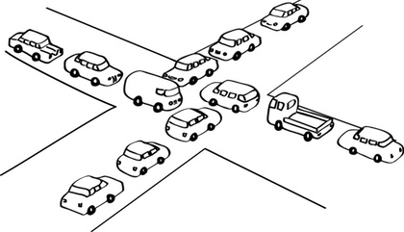
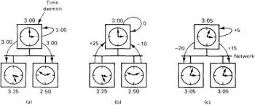
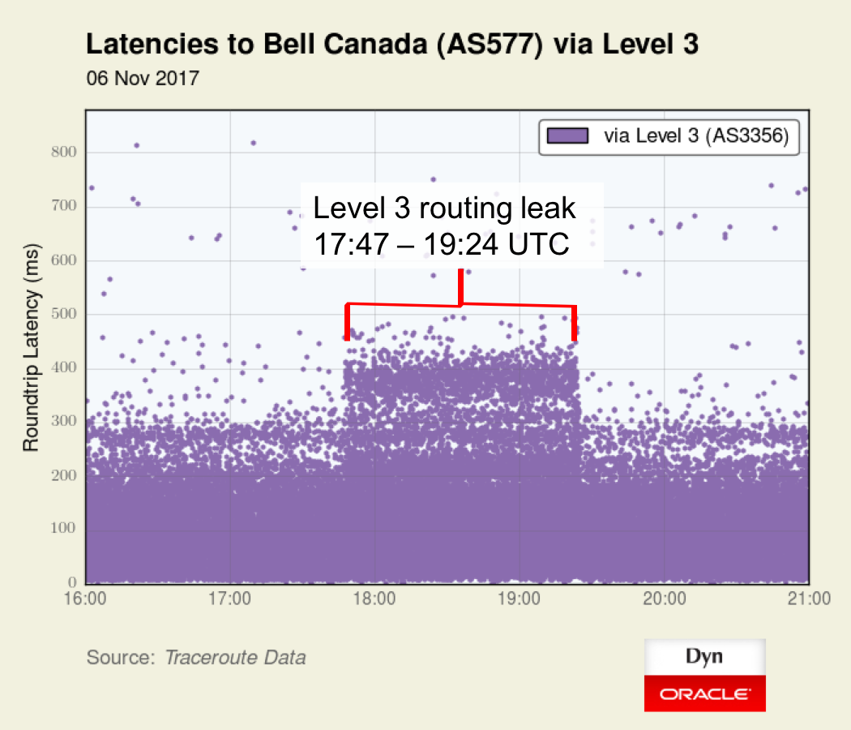
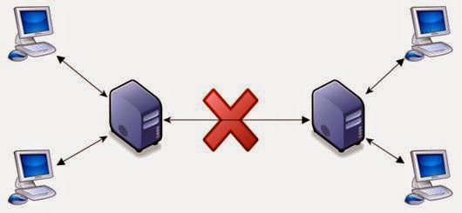
Distributed Systems are Notoriously Difficult to Build
Concurrency
No Centralized Clock
Partial Failure
Network Variance
Notes:
Concurrency - Distributed systems are inherently concurrent, achieving even a modest amount of synchronization can come at a huge performance penalty. Developers are often forced to use specialized techniques and structures (eventual consistancy, crdt) in order to manage this inherent concurrency.
No Centralized Clock - In addition to concurrency, distributed systems lack a centralized clock. In this context tracking time is costly and diffucult, often causality, and the happens-before relation are the only means of ordering and resasoning about events.
Partial Failures - Lamport’s popular quote “A distributed system is one in which the failure of a computer you didn't even know existed can render your own computer unusable.”

Slide 4


It’s okay, Developers don’t make mistakes!
Notes:
**This part of the presentation will have to be honed for to achieve the best affect.
Stage note: This should be led into hard from the previous slide, after listing off each of the troubles on the prior slide I should lead into this one by making a small argument to pathos
-As i’m sure you are all aware, especally after the 3 testing, and debugging sessions
-It’s Okay, Developers dont make mistakes, all software does exactly what it’s supposed to everytime
Stage Note: Queue some indicator that this silly strawman is not the case
In fact testing, debugging, and developing distributed systems is extremely difficult (More of an art than a science / largely best effort)

Slide 5
Today’s state of the art (building robust dist. sys)
Verification - [ (verification) IronFleet SOSP’15, VerdiPLDI’15, Chapar POPL’16, (modeling), Lamport et.al SIGOPS’02, Holtzman IEEE TSE’97]
Bug Detection - [MODIST NSDI’09, Demi NSDI’16,]
Runtime Checkers - [ D3S NSDI’18, ]
Tracing - [PivotTracing SOSP’15, XTrace NSDI’07, Dapper TR’10, ]
Log Analysis - [ShiViz CACM ‘16]
Notes:
Verification [ IronFleet, Verdi, Chapar;
TLA+, Spin,
Bug Detection [ Modist, Demi, ]
Runtime Checkers [ D3S ]
Tracing - PivotTracing, X-Trace, Dapper
Log Analysis - ShiViz CACM’16,

Slide 6
Today’s state of the art (building robust dist. sys)
Verification - [ (verification) IronFleet SOSP’15, VerdiPLDI’15, Chapar POPL’16, (modeling), Lamport et.al SIGOPS’02, Holtzman IEEE TSE’97]
Bug Detection - [MODIST NSDI’09, Demi NSDI’16,]
Runtime Checkers - [ D3S NSDI’18, ]
←Require Specifications
Tracing - [PivotTracing SOSP’15, XTrace NSDI’07, Dapper TR’10, ]
Log Analysis - [ShiViz CACM ‘16]
Notes:
Verification [ IronFleet, Verdi, Chapar;
TLA+, Spin,
Bug Detection [ Modist, Demi, ]
Runtime Checkers [ D3S ]
Tracing - PivotTracing, X-Trace, Dapper
Log Analysis - ShiViz CACM’16,

Slide 7
Little work has been done to infer distributed specs
Some notable exceptions
CSight ICSE’14
Communicatin finite state machines
Avenger SRDS’11
Requires enormous manual effort
Udon ICSE’15
Requires shared state
None of these can capture stateful properties like:
Partitioned Key Space (Memcached):
∀nodes i,j keys_i != keys_j
Strong Leadership (raft)
∀followers i length(log_leader) >= length(log_follower_i)

Slide 8
Design goal: handle real distributed systems
Wanted: distributed state invariants
Make the fewest assumptions about the system as possible.
N nodes
Message passing
Lossy, reorderable channels
Joins and failures

Slide 9
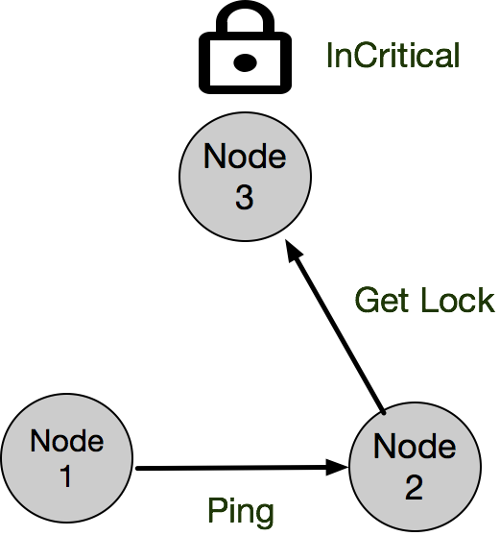
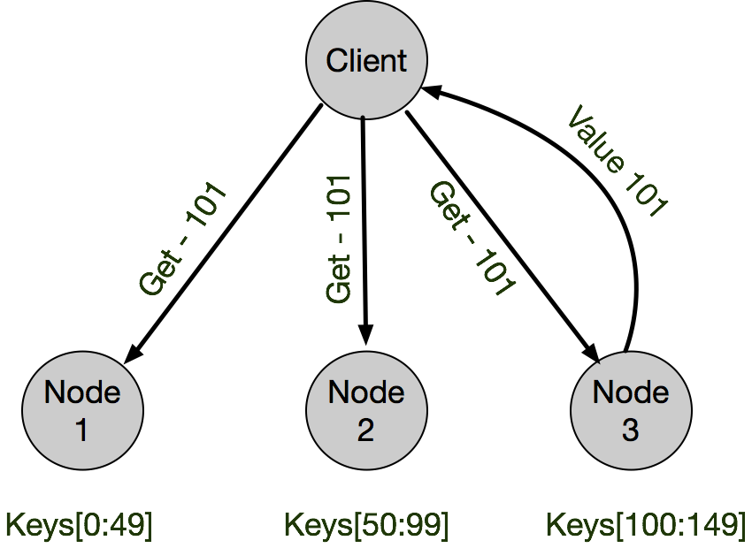
Goal: Infer key correctness and safety properties
Mutual exclusion:
∀nodes i,j InCritical_i →¬InCritical_j
Key Partitioning:
∀nodes i, j keys_i != keys_j

Slide 10
Goal: Infer key correctness and safety properties
Mutual exclusion:
∀nodes i,j InCritical_i →¬InCritical_j
Key Partitioning:
∀nodes i, j keys_i != keys_j
“Distributed State”

Slide 11
Goal: Infer key correctness and safety properties
Mutual exclusion:
∀nodes i,j InCritical_i →¬InCritical_j
Key Partitioning:
∀nodes i, j keys_i != keys_j
“Distributed State”
Running Example

Slide 12
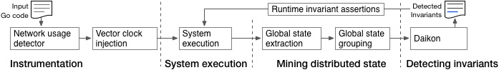
This talk: distributed invariants and Dinv
Automatic distributed invariant inference (techniques & challenges)
Runtime checking: distributed assertions
Evaluation: 4 large scale distributed systems
Static Analysis
Dynamic Analysis

Slide 13
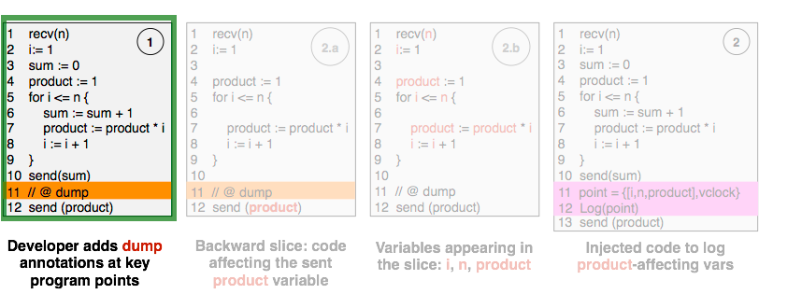
Capturing Distributed State Automatically
Interprocedural Program Slicing
Logging Code Injection
Notes:
Dinv automatically instruments distributed programs to capture their runtime behaviour. Dinv’s analysis is state based, the data that it captures is the runtime state of variables in the distributed system. The number of variables in distributed programs is large, and the number of invariants which can hold across these variables is exponentially larger. For practicality, and higher quality invariants, only variables which directly or indirectly interact with the network are logged for inference. We use interprocedural program slicing to from network endpoints to calculate this set of relevent variables. To reason about time from distributed logs (with no assumptions about centralized clocks) Dinv injects vector clocks onto messages, and logs them.

Slide 14
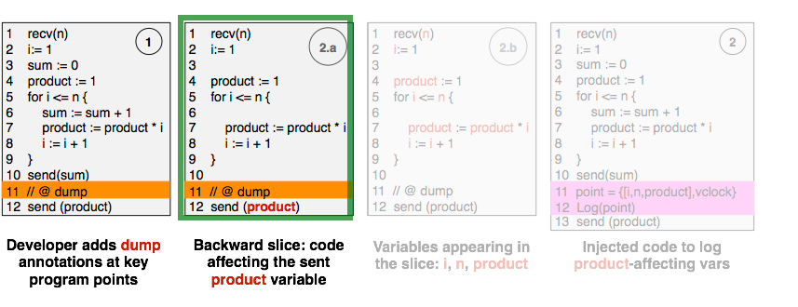
Capturing Distributed State Automatically
Interprocedural Program Slicing
Logging Code Injection
Notes:
Dinv automatically instruments distributed programs to capture their runtime behaviour. Dinv’s analysis is state based, the data that it captures is the runtime state of variables in the distributed system. The number of variables in distributed programs is large, and the number of invariants which can hold across these variables is exponentially larger. For practicality, and higher quality invariants, only variables which directly or indirectly interact with the network are logged for inference. We use interprocedural program slicing to from network endpoints to calculate this set of relevent variables. To reason about time from distributed logs (with no assumptions about centralized clocks) Dinv injects vector clocks onto messages, and logs them.

Slide 15
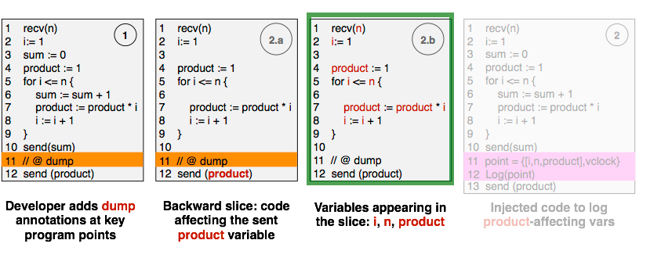
Capturing Distributed State Automatically
Interprocedural Program Slicing
Logging Code Injection
Notes:
Dinv automatically instruments distributed programs to capture their runtime behaviour. Dinv’s analysis is state based, the data that it captures is the runtime state of variables in the distributed system. The number of variables in distributed programs is large, and the number of invariants which can hold across these variables is exponentially larger. For practicality, and higher quality invariants, only variables which directly or indirectly interact with the network are logged for inference. We use interprocedural program slicing to from network endpoints to calculate this set of relevent variables. To reason about time from distributed logs (with no assumptions about centralized clocks) Dinv injects vector clocks onto messages, and logs them.

Slide 16
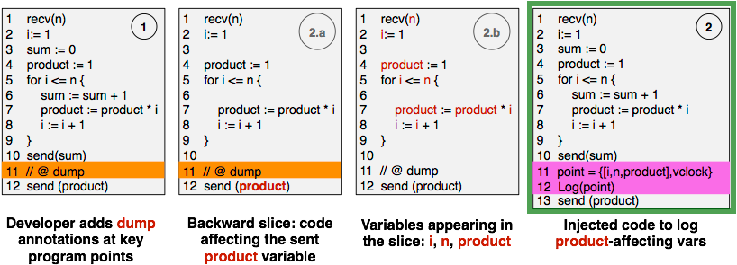
Capturing Distributed State Automatically
Interprocedural Program Slicing
Logging Code Injection
Notes:
Dinv automatically instruments distributed programs to capture their runtime behaviour. Dinv’s analysis is state based, the data that it captures is the runtime state of variables in the distributed system. The number of variables in distributed programs is large, and the number of invariants which can hold across these variables is exponentially larger. For practicality, and higher quality invariants, only variables which directly or indirectly interact with the network are logged for inference. We use interprocedural program slicing to from network endpoints to calculate this set of relevent variables. To reason about time from distributed logs (with no assumptions about centralized clocks) Dinv injects vector clocks onto messages, and logs them.

Slide 17
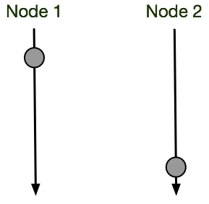

Capturing Distributed State Automatically
Interprocedural Program Slicing
Logging Code Injection
Notes:
Dinv automatically instruments distributed programs to capture their runtime behaviour. Dinv’s analysis is state based, the data that it captures is the runtime state of variables in the distributed system. The number of variables in distributed programs is large, and the number of invariants which can hold across these variables is exponentially larger. For practicality, and higher quality invariants, only variables which directly or indirectly interact with the network are logged for inference. We use interprocedural program slicing to from network endpoints to calculate this set of relevent variables. To reason about time from distributed logs (with no assumptions about centralized clocks) Dinv injects vector clocks onto messages, and logs them.

Slide 18
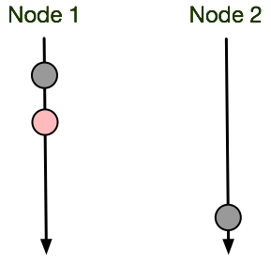
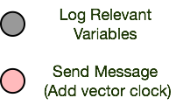
Capturing Distributed State Automatically
Interprocedural Program Slicing
Logging Code Injection
Vector Clock Injection
Notes:
Dinv automatically instruments distributed programs to capture their runtime behaviour. Dinv’s analysis is state based, the data that it captures is the runtime state of variables in the distributed system. The number of variables in distributed programs is large, and the number of invariants which can hold across these variables is exponentially larger. For practicality, and higher quality invariants, only variables which directly or indirectly interact with the network are logged for inference. We use interprocedural program slicing to from network endpoints to calculate this set of relevent variables. To reason about time from distributed logs (with no assumptions about centralized clocks) Dinv injects vector clocks onto messages, and logs them.

Slide 19
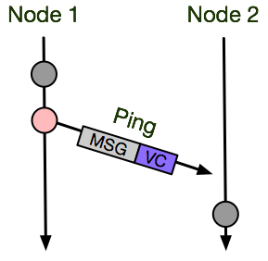
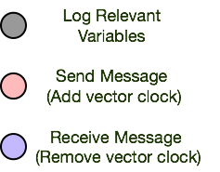
Capturing Distributed State Automatically
Interprocedural Program Slicing
Logging Code Injection
Vector Clock Injection
Notes:
Dinv automatically instruments distributed programs to capture their runtime behaviour. Dinv’s analysis is state based, the data that it captures is the runtime state of variables in the distributed system. The number of variables in distributed programs is large, and the number of invariants which can hold across these variables is exponentially larger. For practicality, and higher quality invariants, only variables which directly or indirectly interact with the network are logged for inference. We use interprocedural program slicing to from network endpoints to calculate this set of relevent variables. To reason about time from distributed logs (with no assumptions about centralized clocks) Dinv injects vector clocks onto messages, and logs them.

Slide 20
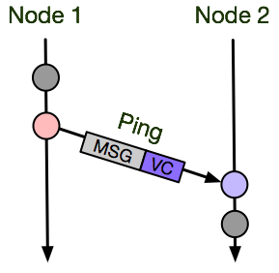
Capturing Distributed State Automatically
Interprocedural Program Slicing
Logging Code Injection
Vector Clock Injection
Notes:
Dinv automatically instruments distributed programs to capture their runtime behaviour. Dinv’s analysis is state based, the data that it captures is the runtime state of variables in the distributed system. The number of variables in distributed programs is large, and the number of invariants which can hold across these variables is exponentially larger. For practicality, and higher quality invariants, only variables which directly or indirectly interact with the network are logged for inference. We use interprocedural program slicing to from network endpoints to calculate this set of relevent variables. To reason about time from distributed logs (with no assumptions about centralized clocks) Dinv injects vector clocks onto messages, and logs them.

Slide 21
Consistent Cuts / Ground States
Interprocedural Program Slicing
Logging Code Injection
Vector Clock Injection
Notes:
Dinv automatically instruments distributed programs to capture their runtime behaviour. Dinv’s analysis is state based, the data that it captures is the runtime state of variables in the distributed system. The number of variables in distributed programs is large, and the number of invariants which can hold across these variables is exponentially larger. For practicality, and higher quality invariants, only variables which directly or indirectly interact with the network are logged for inference. We use interprocedural program slicing to from network endpoints to calculate this set of relevent variables. To reason about time from distributed logs (with no assumptions about centralized clocks) Dinv injects vector clocks onto messages, and logs them.

Slide 22
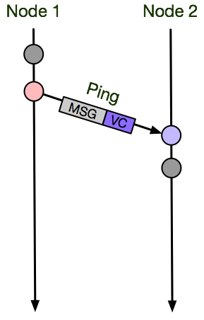
Consistent Cuts / Ground States
Fast Forward
Notes:
Dinv automatically instruments distributed programs to capture their runtime behaviour. Dinv’s analysis is state based, the data that it captures is the runtime state of variables in the distributed system. The number of variables in distributed programs is large, and the number of invariants which can hold across these variables is exponentially larger. For practicality, and higher quality invariants, only variables which directly or indirectly interact with the network are logged for inference. We use interprocedural program slicing to from network endpoints to calculate this set of relevent variables. To reason about time from distributed logs (with no assumptions about centralized clocks) Dinv injects vector clocks onto messages, and logs them.

Slide 23
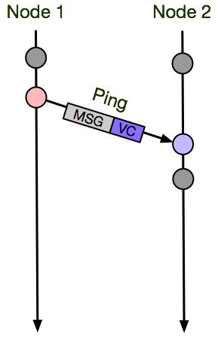
Consistent Cuts / Ground States
Fast Forward.
Notes:
Dinv automatically instruments distributed programs to capture their runtime behaviour. Dinv’s analysis is state based, the data that it captures is the runtime state of variables in the distributed system. The number of variables in distributed programs is large, and the number of invariants which can hold across these variables is exponentially larger. For practicality, and higher quality invariants, only variables which directly or indirectly interact with the network are logged for inference. We use interprocedural program slicing to from network endpoints to calculate this set of relevent variables. To reason about time from distributed logs (with no assumptions about centralized clocks) Dinv injects vector clocks onto messages, and logs them.

Slide 24
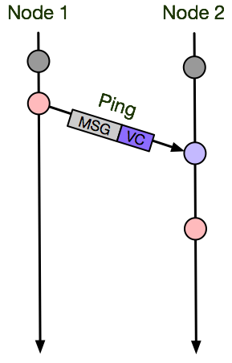
Consistent Cuts / Ground States
Fast Forward..
Notes:
Dinv automatically instruments distributed programs to capture their runtime behaviour. Dinv’s analysis is state based, the data that it captures is the runtime state of variables in the distributed system. The number of variables in distributed programs is large, and the number of invariants which can hold across these variables is exponentially larger. For practicality, and higher quality invariants, only variables which directly or indirectly interact with the network are logged for inference. We use interprocedural program slicing to from network endpoints to calculate this set of relevent variables. To reason about time from distributed logs (with no assumptions about centralized clocks) Dinv injects vector clocks onto messages, and logs them.

Slide 25
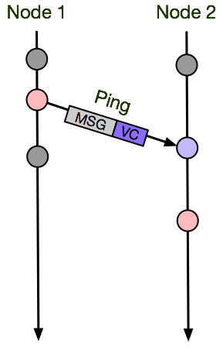
Consistent Cuts / Ground States
Fast Forward...
Notes:
Dinv automatically instruments distributed programs to capture their runtime behaviour. Dinv’s analysis is state based, the data that it captures is the runtime state of variables in the distributed system. The number of variables in distributed programs is large, and the number of invariants which can hold across these variables is exponentially larger. For practicality, and higher quality invariants, only variables which directly or indirectly interact with the network are logged for inference. We use interprocedural program slicing to from network endpoints to calculate this set of relevent variables. To reason about time from distributed logs (with no assumptions about centralized clocks) Dinv injects vector clocks onto messages, and logs them.

Slide 26
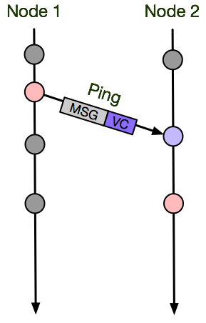
Consistent Cuts / Ground States
Fast Forward….
Notes:
Dinv automatically instruments distributed programs to capture their runtime behaviour. Dinv’s analysis is state based, the data that it captures is the runtime state of variables in the distributed system. The number of variables in distributed programs is large, and the number of invariants which can hold across these variables is exponentially larger. For practicality, and higher quality invariants, only variables which directly or indirectly interact with the network are logged for inference. We use interprocedural program slicing to from network endpoints to calculate this set of relevent variables. To reason about time from distributed logs (with no assumptions about centralized clocks) Dinv injects vector clocks onto messages, and logs them.

Slide 27
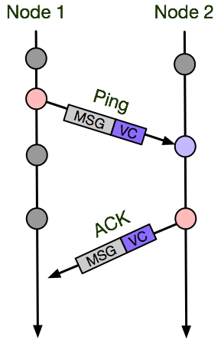
Consistent Cuts / Ground States
Fast Forward…...
Notes:
Dinv automatically instruments distributed programs to capture their runtime behaviour. Dinv’s analysis is state based, the data that it captures is the runtime state of variables in the distributed system. The number of variables in distributed programs is large, and the number of invariants which can hold across these variables is exponentially larger. For practicality, and higher quality invariants, only variables which directly or indirectly interact with the network are logged for inference. We use interprocedural program slicing to from network endpoints to calculate this set of relevent variables. To reason about time from distributed logs (with no assumptions about centralized clocks) Dinv injects vector clocks onto messages, and logs them.

Slide 28
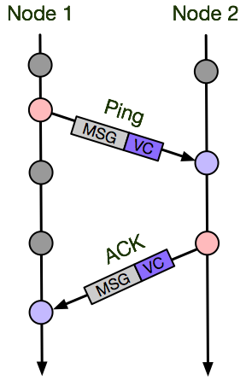
Consistent Cuts / Ground States
Fast Forward…….
Notes:
Dinv automatically instruments distributed programs to capture their runtime behaviour. Dinv’s analysis is state based, the data that it captures is the runtime state of variables in the distributed system. The number of variables in distributed programs is large, and the number of invariants which can hold across these variables is exponentially larger. For practicality, and higher quality invariants, only variables which directly or indirectly interact with the network are logged for inference. We use interprocedural program slicing to from network endpoints to calculate this set of relevent variables. To reason about time from distributed logs (with no assumptions about centralized clocks) Dinv injects vector clocks onto messages, and logs them.

Slide 29
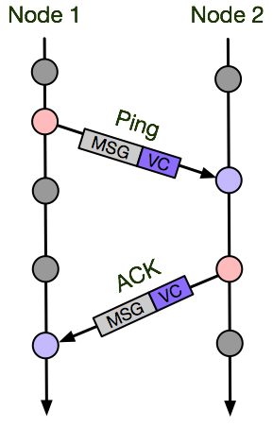
Consistent Cuts / Ground States
Fast Forward……..
Notes:
Dinv automatically instruments distributed programs to capture their runtime behaviour. Dinv’s analysis is state based, the data that it captures is the runtime state of variables in the distributed system. The number of variables in distributed programs is large, and the number of invariants which can hold across these variables is exponentially larger. For practicality, and higher quality invariants, only variables which directly or indirectly interact with the network are logged for inference. We use interprocedural program slicing to from network endpoints to calculate this set of relevent variables. To reason about time from distributed logs (with no assumptions about centralized clocks) Dinv injects vector clocks onto messages, and logs them.

Slide 30
Consistent Cuts / Ground States
Green lines mark consistent cuts
No messages are in flight
Message sent but not received
The red line is not a consistent cut
The ping sent by Node 0 happened before the pings receipt on node 1.
Notes:
Dinv automatically instruments distributed programs to capture their runtime behaviour. Dinv’s analysis is state based, the data that it captures is the runtime state of variables in the distributed system. The number of variables in distributed programs is large, and the number of invariants which can hold across these variables is exponentially larger. For practicality, and higher quality invariants, only variables which directly or indirectly interact with the network are logged for inference. We use interprocedural program slicing to from network endpoints to calculate this set of relevent variables. To reason about time from distributed logs (with no assumptions about centralized clocks) Dinv injects vector clocks onto messages, and logs them.

Slide 31
Consistent Cuts / Ground States
Huge number of consistent cuts
Notes:
Dinv automatically instruments distributed programs to capture their runtime behaviour. Dinv’s analysis is state based, the data that it captures is the runtime state of variables in the distributed system. The number of variables in distributed programs is large, and the number of invariants which can hold across these variables is exponentially larger. For practicality, and higher quality invariants, only variables which directly or indirectly interact with the network are logged for inference. We use interprocedural program slicing to from network endpoints to calculate this set of relevent variables. To reason about time from distributed logs (with no assumptions about centralized clocks) Dinv injects vector clocks onto messages, and logs them.

Slide 32
Consistent Cuts / Ground States
Huge number of consistent cuts
Require sampling heuristic
Notes:
Dinv automatically instruments distributed programs to capture their runtime behaviour. Dinv’s analysis is state based, the data that it captures is the runtime state of variables in the distributed system. The number of variables in distributed programs is large, and the number of invariants which can hold across these variables is exponentially larger. For practicality, and higher quality invariants, only variables which directly or indirectly interact with the network are logged for inference. We use interprocedural program slicing to from network endpoints to calculate this set of relevent variables. To reason about time from distributed logs (with no assumptions about centralized clocks) Dinv injects vector clocks onto messages, and logs them.

Slide 33
Consistent Cuts / Ground States
Huge number of consistent cuts
Require sampling heuristic
Ground States: A consistent cut with no in flight messages
Notes:
Dinv automatically instruments distributed programs to capture their runtime behaviour. Dinv’s analysis is state based, the data that it captures is the runtime state of variables in the distributed system. The number of variables in distributed programs is large, and the number of invariants which can hold across these variables is exponentially larger. For practicality, and higher quality invariants, only variables which directly or indirectly interact with the network are logged for inference. We use interprocedural program slicing to from network endpoints to calculate this set of relevent variables. To reason about time from distributed logs (with no assumptions about centralized clocks) Dinv injects vector clocks onto messages, and logs them.

Slide 34
Consistent Cuts / Ground States
Huge number of consistent cuts
Require sampling heuristic
Ground States: A consistent cut with no in flight messages
Dramatically collapses search space
Notes:
Dinv automatically instruments distributed programs to capture their runtime behaviour. Dinv’s analysis is state based, the data that it captures is the runtime state of variables in the distributed system. The number of variables in distributed programs is large, and the number of invariants which can hold across these variables is exponentially larger. For practicality, and higher quality invariants, only variables which directly or indirectly interact with the network are logged for inference. We use interprocedural program slicing to from network endpoints to calculate this set of relevent variables. To reason about time from distributed logs (with no assumptions about centralized clocks) Dinv injects vector clocks onto messages, and logs them.

Slide 35
Consistent Cuts / Ground States
Huge number of consistent cuts
Require sampling heuristic
Ground States: A consistent cut with no in flight messages
Dramatically collapses search space
Ground State sampling used exclusively in evaluation
Notes:
Dinv automatically instruments distributed programs to capture their runtime behaviour. Dinv’s analysis is state based, the data that it captures is the runtime state of variables in the distributed system. The number of variables in distributed programs is large, and the number of invariants which can hold across these variables is exponentially larger. For practicality, and higher quality invariants, only variables which directly or indirectly interact with the network are logged for inference. We use interprocedural program slicing to from network endpoints to calculate this set of relevent variables. To reason about time from distributed logs (with no assumptions about centralized clocks) Dinv injects vector clocks onto messages, and logs them.

Slide 36
Consistent Cuts / Ground States
The old text for consistant cuts and Ground states was pretty good, if possible that same animation should be done to the prior example. First the explosion is shown, then Ground states followed by the reduction - we do this automatially from logs, if future interest in ground state analysis exists outside of invariant inference, dinv can provide them off the shelf
The last part of this set of slides should be a transition into the tripple execution in the next set of slides.

Slide 37
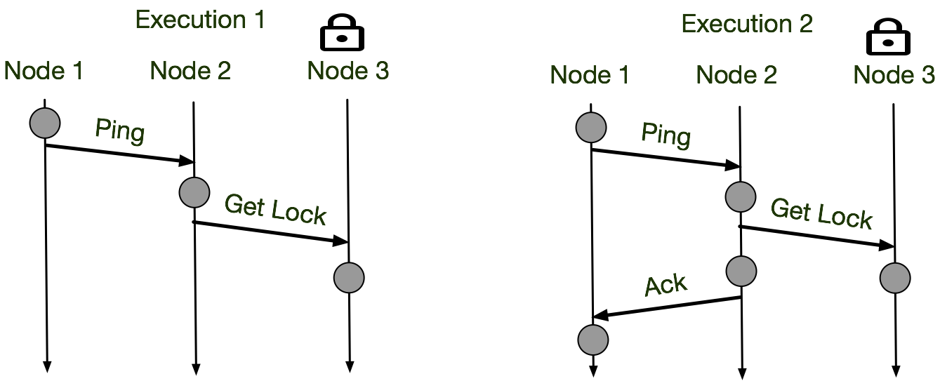
Reasoning About Global State: State Bucketing
Notes:
Logs generated with vector clocks form a partial order on the execution. The number of consistent, potentially valid, global states is exponential in the length of the execution, and the number of participating nodes. This double exponentially makes analyzing all states intractable. Dinv uses “ground states - global states in which no messages are in flight” as a sampling heuristic to collapse the number of partial orderings. In antagonistic executions ground states are not present, but in the executions of real systems they are frequent, and were sufficient to detect a large class of invariants in our evaluation. Post execution a variety of communication patterns are extracted from the global states. Reoccurring communication patterns, with matching sets of logged variables are bucketed together. Each bucket is used as input to daikon, the invariant inference tool, which treats each instance of the communication pattern as evidence for the invariants that hold across it’s subset of global state.

Slide 38
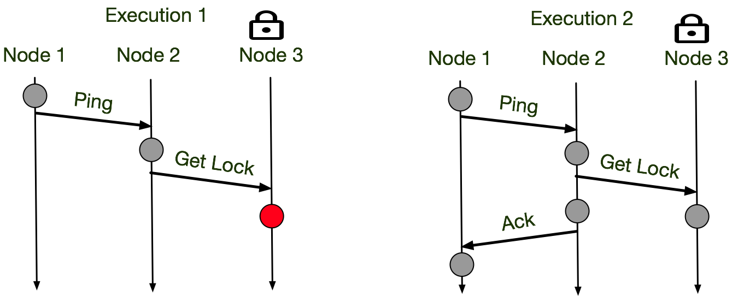
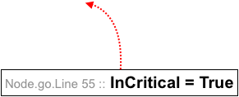
Reasoning About Global State: State Bucketing
Notes:
Logs generated with vector clocks form a partial order on the execution. The number of consistent, potentially valid, global states is exponential in the length of the execution, and the number of participating nodes. This double exponentially makes analyzing all states intractable. Dinv uses “ground states - global states in which no messages are in flight” as a sampling heuristic to collapse the number of partial orderings. In antagonistic executions ground states are not present, but in the executions of real systems they are frequent, and were sufficient to detect a large class of invariants in our evaluation. Post execution a variety of communication patterns are extracted from the global states. Reoccurring communication patterns, with matching sets of logged variables are bucketed together. Each bucket is used as input to daikon, the invariant inference tool, which treats each instance of the communication pattern as evidence for the invariants that hold across it’s subset of global state.

Slide 39
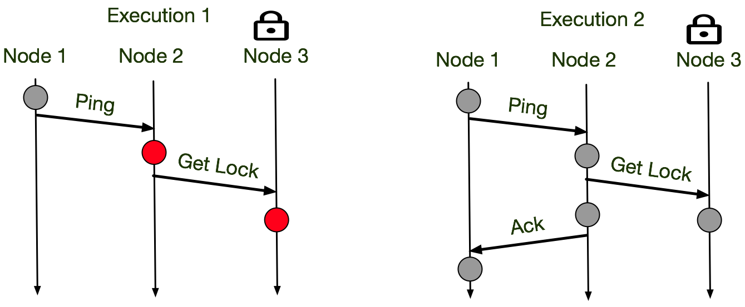
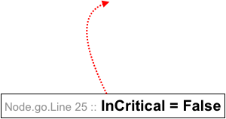
Reasoning About Global State: State Bucketing
Notes:
Logs generated with vector clocks form a partial order on the execution. The number of consistent, potentially valid, global states is exponential in the length of the execution, and the number of participating nodes. This double exponentially makes analyzing all states intractable. Dinv uses “ground states - global states in which no messages are in flight” as a sampling heuristic to collapse the number of partial orderings. In antagonistic executions ground states are not present, but in the executions of real systems they are frequent, and were sufficient to detect a large class of invariants in our evaluation. Post execution a variety of communication patterns are extracted from the global states. Reoccurring communication patterns, with matching sets of logged variables are bucketed together. Each bucket is used as input to daikon, the invariant inference tool, which treats each instance of the communication pattern as evidence for the invariants that hold across it’s subset of global state.

Slide 40
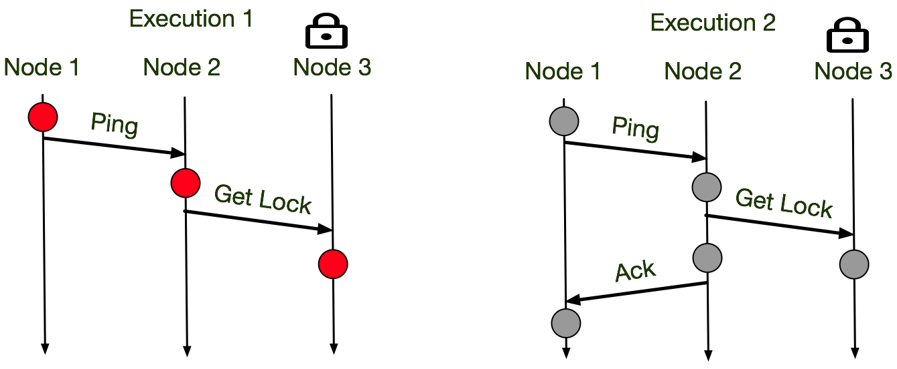
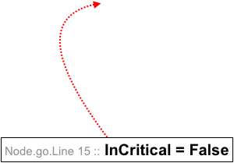
Reasoning About Global State: State Bucketing
Notes:
Logs generated with vector clocks form a partial order on the execution. The number of consistent, potentially valid, global states is exponential in the length of the execution, and the number of participating nodes. This double exponentially makes analyzing all states intractable. Dinv uses “ground states - global states in which no messages are in flight” as a sampling heuristic to collapse the number of partial orderings. In antagonistic executions ground states are not present, but in the executions of real systems they are frequent, and were sufficient to detect a large class of invariants in our evaluation. Post execution a variety of communication patterns are extracted from the global states. Reoccurring communication patterns, with matching sets of logged variables are bucketed together. Each bucket is used as input to daikon, the invariant inference tool, which treats each instance of the communication pattern as evidence for the invariants that hold across it’s subset of global state.

Slide 41
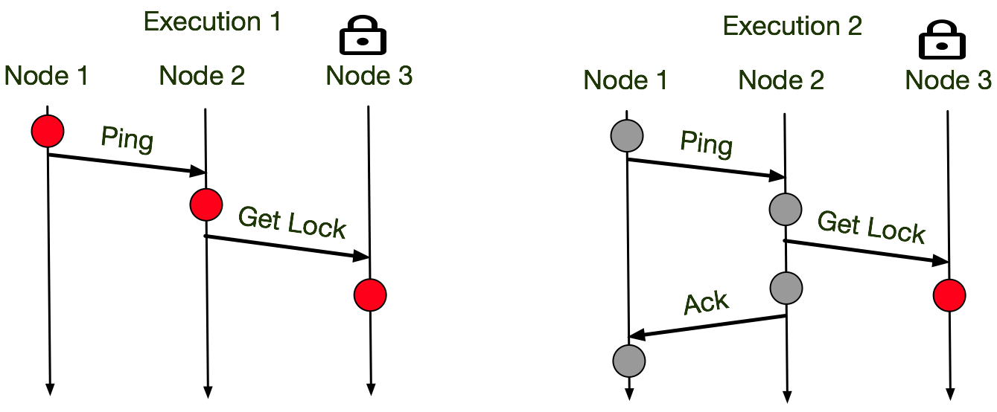
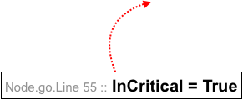
Reasoning About Global State: State Bucketing
=
Notes:
Logs generated with vector clocks form a partial order on the execution. The number of consistent, potentially valid, global states is exponential in the length of the execution, and the number of participating nodes. This double exponentially makes analyzing all states intractable. Dinv uses “ground states - global states in which no messages are in flight” as a sampling heuristic to collapse the number of partial orderings. In antagonistic executions ground states are not present, but in the executions of real systems they are frequent, and were sufficient to detect a large class of invariants in our evaluation. Post execution a variety of communication patterns are extracted from the global states. Reoccurring communication patterns, with matching sets of logged variables are bucketed together. Each bucket is used as input to daikon, the invariant inference tool, which treats each instance of the communication pattern as evidence for the invariants that hold across it’s subset of global state.

Slide 42
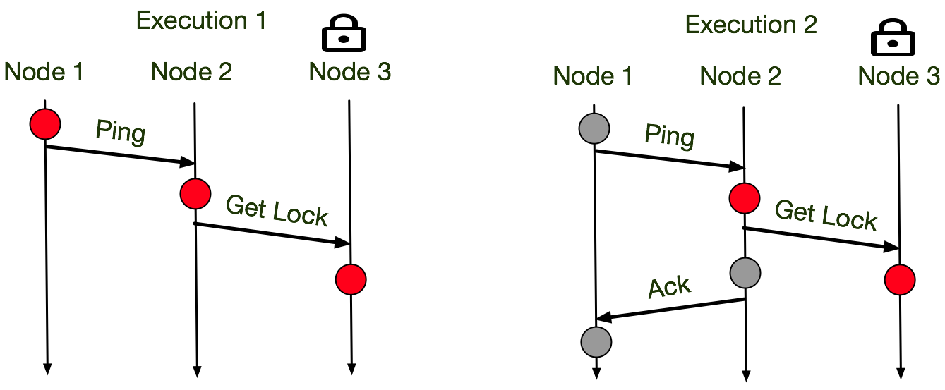
Reasoning About Global State: State Bucketing
Notes:
Logs generated with vector clocks form a partial order on the execution. The number of consistent, potentially valid, global states is exponential in the length of the execution, and the number of participating nodes. This double exponentially makes analyzing all states intractable. Dinv uses “ground states - global states in which no messages are in flight” as a sampling heuristic to collapse the number of partial orderings. In antagonistic executions ground states are not present, but in the executions of real systems they are frequent, and were sufficient to detect a large class of invariants in our evaluation. Post execution a variety of communication patterns are extracted from the global states. Reoccurring communication patterns, with matching sets of logged variables are bucketed together. Each bucket is used as input to daikon, the invariant inference tool, which treats each instance of the communication pattern as evidence for the invariants that hold across it’s subset of global state.

Slide 43
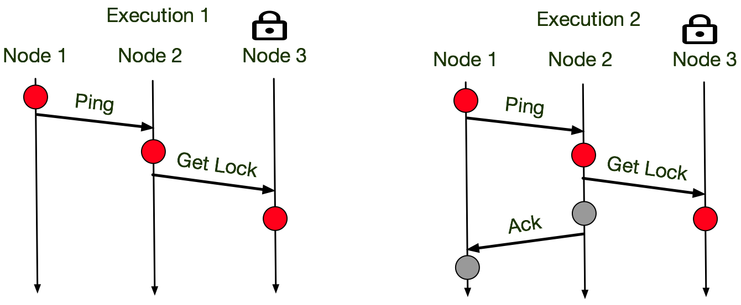
Reasoning About Global State: State Bucketing
Notes:
Logs generated with vector clocks form a partial order on the execution. The number of consistent, potentially valid, global states is exponential in the length of the execution, and the number of participating nodes. This double exponentially makes analyzing all states intractable. Dinv uses “ground states - global states in which no messages are in flight” as a sampling heuristic to collapse the number of partial orderings. In antagonistic executions ground states are not present, but in the executions of real systems they are frequent, and were sufficient to detect a large class of invariants in our evaluation. Post execution a variety of communication patterns are extracted from the global states. Reoccurring communication patterns, with matching sets of logged variables are bucketed together. Each bucket is used as input to daikon, the invariant inference tool, which treats each instance of the communication pattern as evidence for the invariants that hold across it’s subset of global state.

Slide 44
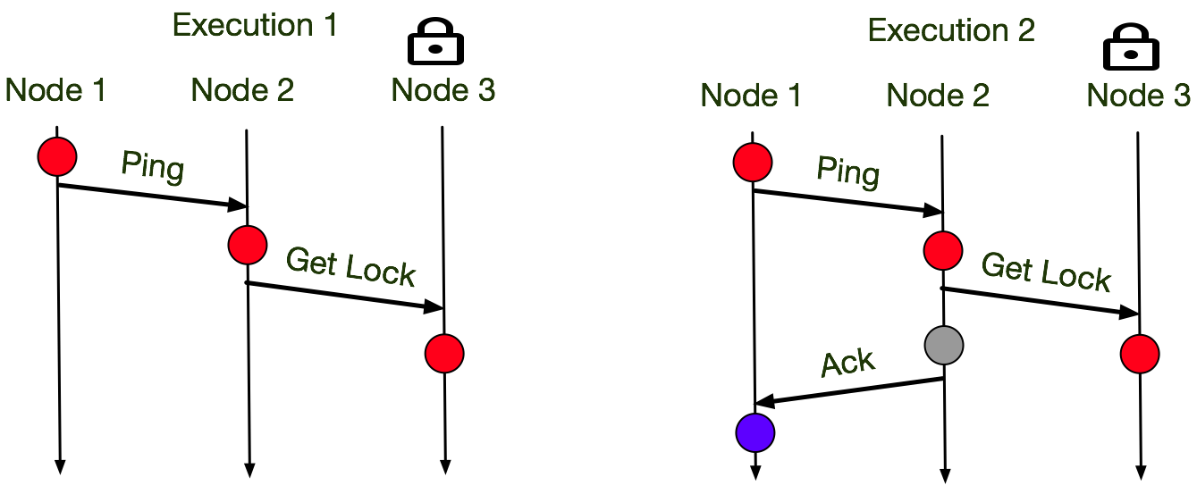
Reasoning About Global State: State Bucketing
Notes:
Logs generated with vector clocks form a partial order on the execution. The number of consistent, potentially valid, global states is exponential in the length of the execution, and the number of participating nodes. This double exponentially makes analyzing all states intractable. Dinv uses “ground states - global states in which no messages are in flight” as a sampling heuristic to collapse the number of partial orderings. In antagonistic executions ground states are not present, but in the executions of real systems they are frequent, and were sufficient to detect a large class of invariants in our evaluation. Post execution a variety of communication patterns are extracted from the global states. Reoccurring communication patterns, with matching sets of logged variables are bucketed together. Each bucket is used as input to daikon, the invariant inference tool, which treats each instance of the communication pattern as evidence for the invariants that hold across it’s subset of global state.

Slide 45
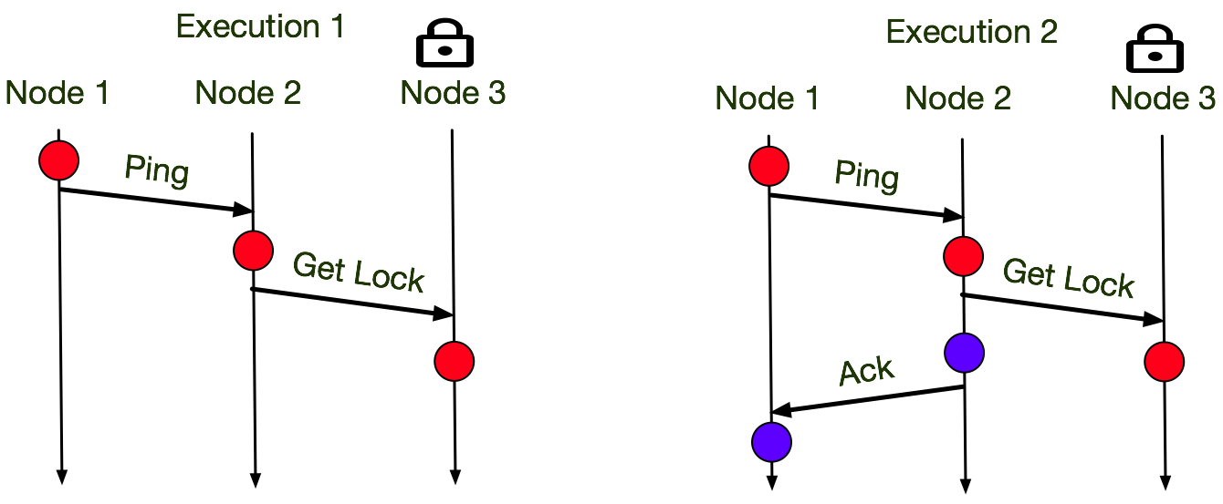
Reasoning About Global State: State Bucketing
Notes:
Logs generated with vector clocks form a partial order on the execution. The number of consistent, potentially valid, global states is exponential in the length of the execution, and the number of participating nodes. This double exponentially makes analyzing all states intractable. Dinv uses “ground states - global states in which no messages are in flight” as a sampling heuristic to collapse the number of partial orderings. In antagonistic executions ground states are not present, but in the executions of real systems they are frequent, and were sufficient to detect a large class of invariants in our evaluation. Post execution a variety of communication patterns are extracted from the global states. Reoccurring communication patterns, with matching sets of logged variables are bucketed together. Each bucket is used as input to daikon, the invariant inference tool, which treats each instance of the communication pattern as evidence for the invariants that hold across it’s subset of global state.

Slide 46
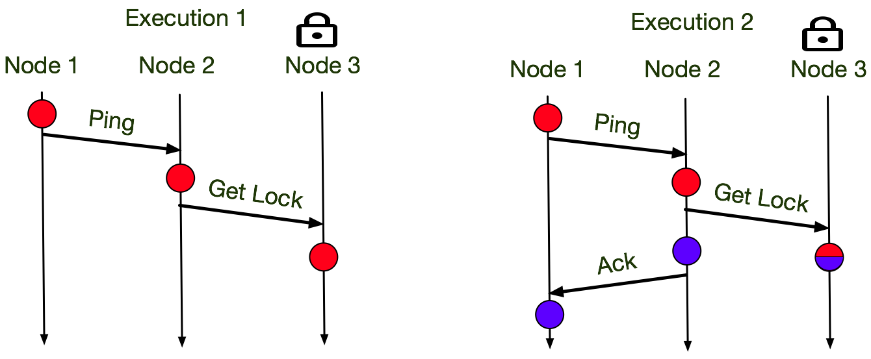
Reasoning About Global State: State Bucketing
Notes:
Logs generated with vector clocks form a partial order on the execution. The number of consistent, potentially valid, global states is exponential in the length of the execution, and the number of participating nodes. This double exponentially makes analyzing all states intractable. Dinv uses “ground states - global states in which no messages are in flight” as a sampling heuristic to collapse the number of partial orderings. In antagonistic executions ground states are not present, but in the executions of real systems they are frequent, and were sufficient to detect a large class of invariants in our evaluation. Post execution a variety of communication patterns are extracted from the global states. Reoccurring communication patterns, with matching sets of logged variables are bucketed together. Each bucket is used as input to daikon, the invariant inference tool, which treats each instance of the communication pattern as evidence for the invariants that hold across it’s subset of global state.

Slide 47
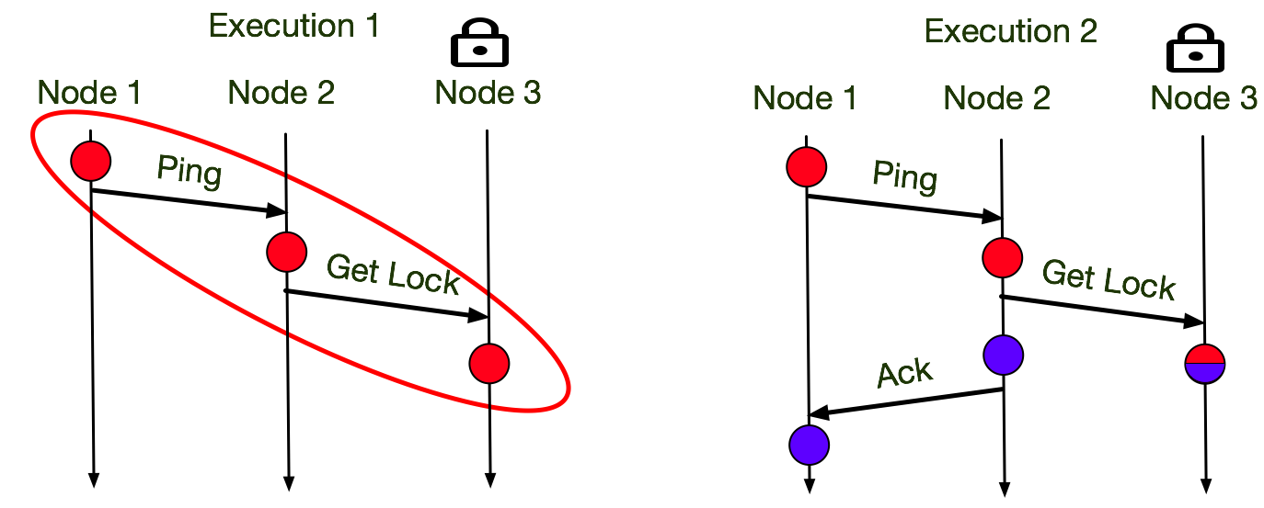
Reasoning About Global State: State Bucketing
Notes:
Logs generated with vector clocks form a partial order on the execution. The number of consistent, potentially valid, global states is exponential in the length of the execution, and the number of participating nodes. This double exponentially makes analyzing all states intractable. Dinv uses “ground states - global states in which no messages are in flight” as a sampling heuristic to collapse the number of partial orderings. In antagonistic executions ground states are not present, but in the executions of real systems they are frequent, and were sufficient to detect a large class of invariants in our evaluation. Post execution a variety of communication patterns are extracted from the global states. Reoccurring communication patterns, with matching sets of logged variables are bucketed together. Each bucket is used as input to daikon, the invariant inference tool, which treats each instance of the communication pattern as evidence for the invariants that hold across it’s subset of global state.

Slide 48
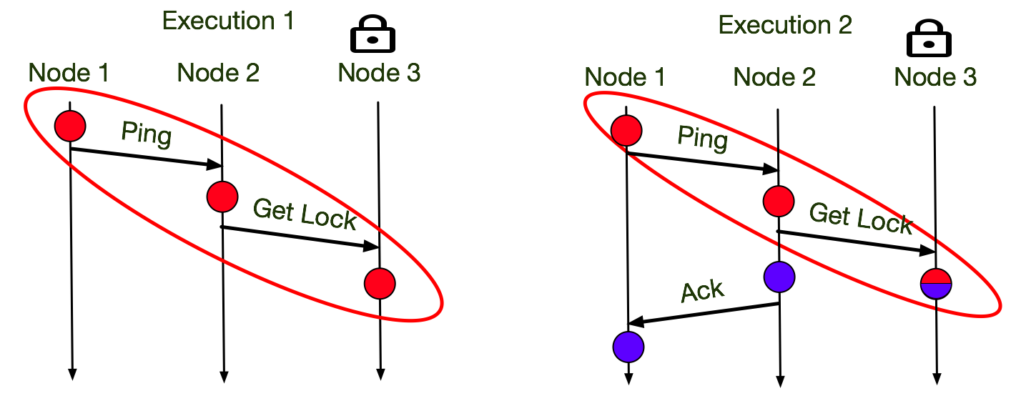
Reasoning About Global State: State Bucketing
Notes:
Logs generated with vector clocks form a partial order on the execution. The number of consistent, potentially valid, global states is exponential in the length of the execution, and the number of participating nodes. This double exponentially makes analyzing all states intractable. Dinv uses “ground states - global states in which no messages are in flight” as a sampling heuristic to collapse the number of partial orderings. In antagonistic executions ground states are not present, but in the executions of real systems they are frequent, and were sufficient to detect a large class of invariants in our evaluation. Post execution a variety of communication patterns are extracted from the global states. Reoccurring communication patterns, with matching sets of logged variables are bucketed together. Each bucket is used as input to daikon, the invariant inference tool, which treats each instance of the communication pattern as evidence for the invariants that hold across it’s subset of global state.

Slide 49
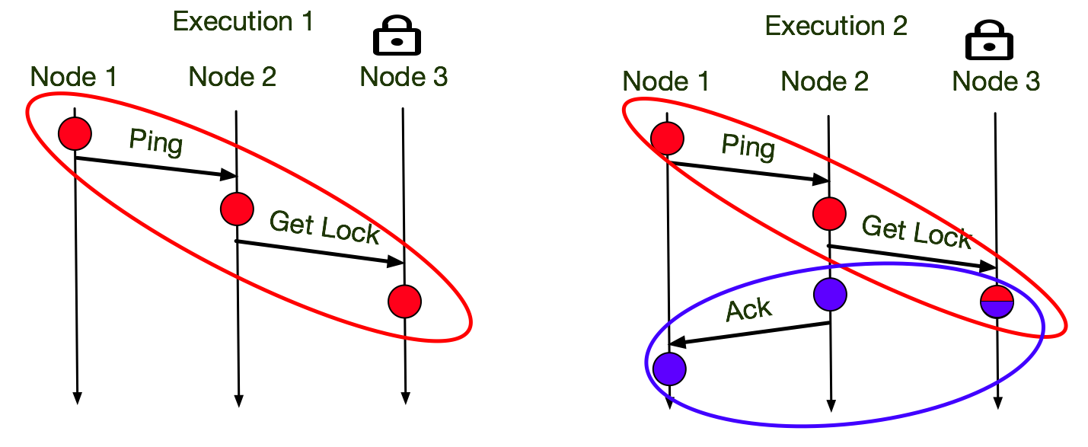
Reasoning About Global State: State Bucketing
Notes:
Logs generated with vector clocks form a partial order on the execution. The number of consistent, potentially valid, global states is exponential in the length of the execution, and the number of participating nodes. This double exponentially makes analyzing all states intractable. Dinv uses “ground states - global states in which no messages are in flight” as a sampling heuristic to collapse the number of partial orderings. In antagonistic executions ground states are not present, but in the executions of real systems they are frequent, and were sufficient to detect a large class of invariants in our evaluation. Post execution a variety of communication patterns are extracted from the global states. Reoccurring communication patterns, with matching sets of logged variables are bucketed together. Each bucket is used as input to daikon, the invariant inference tool, which treats each instance of the communication pattern as evidence for the invariants that hold across it’s subset of global state.

Slide 50
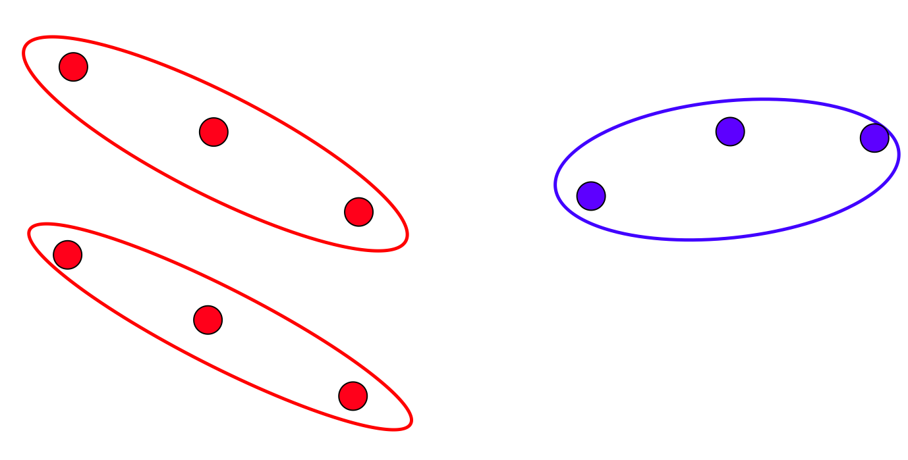

Reasoning About Global State: State Bucketing
...
Node_3_InCritical == True
Node_2_InCritical != Node_3_InCritical
Node_2_InCritical == Node_1_InCritical
“Likely” Invariants
Notes:
Logs generated with vector clocks form a partial order on the execution. The number of consistent, potentially valid, global states is exponential in the length of the execution, and the number of participating nodes. This double exponentially makes analyzing all states intractable. Dinv uses “ground states - global states in which no messages are in flight” as a sampling heuristic to collapse the number of partial orderings. In antagonistic executions ground states are not present, but in the executions of real systems they are frequent, and were sufficient to detect a large class of invariants in our evaluation. Post execution a variety of communication patterns are extracted from the global states. Reoccurring communication patterns, with matching sets of logged variables are bucketed together. Each bucket is used as input to daikon, the invariant inference tool, which treats each instance of the communication pattern as evidence for the invariants that hold across it’s subset of global state.

Slide 51
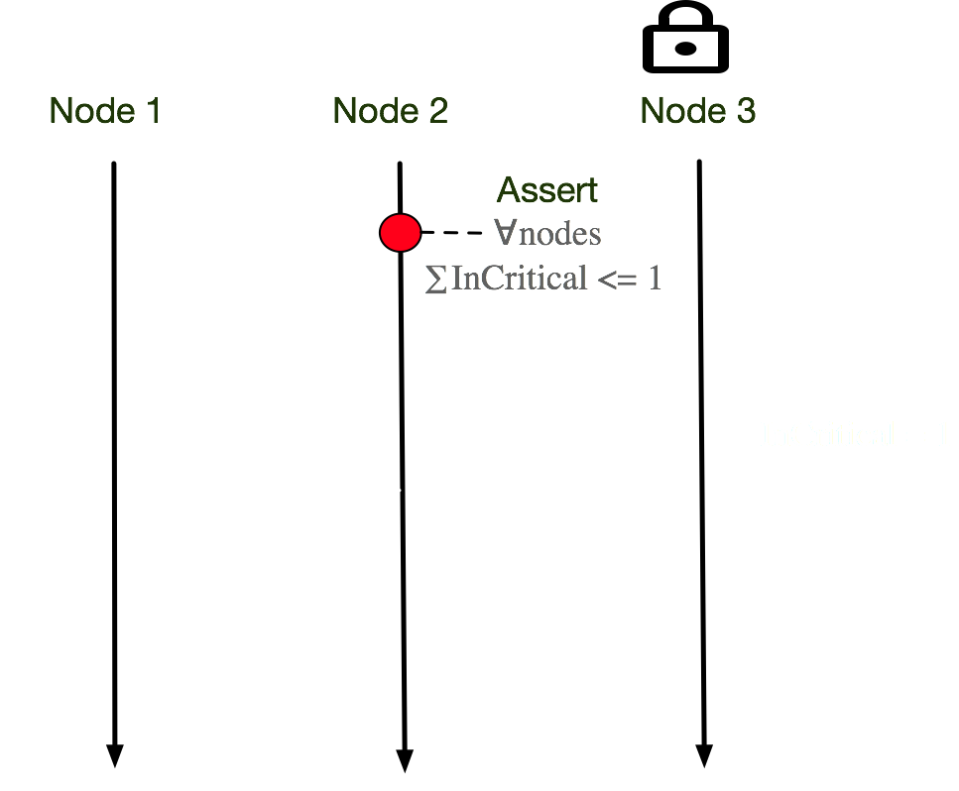
Distributed Asserts
Distributed asserts enforce invariants at runtime
Notes:
Dinv provides a lightweight mechanism for enforcing infrared invariants via distributed asserts. Dinv asserts are broadcast by an asserter, and a state snapshot is scheduled in a synchronized fashion. The snapshot is aggregated back to the asserter which can then compose the distributed state and evaluate the assertion. Vector clocks are used to resolve the quality of the snapshot, ie if the synchronized snapshot violated the happens-before relation.

Slide 52
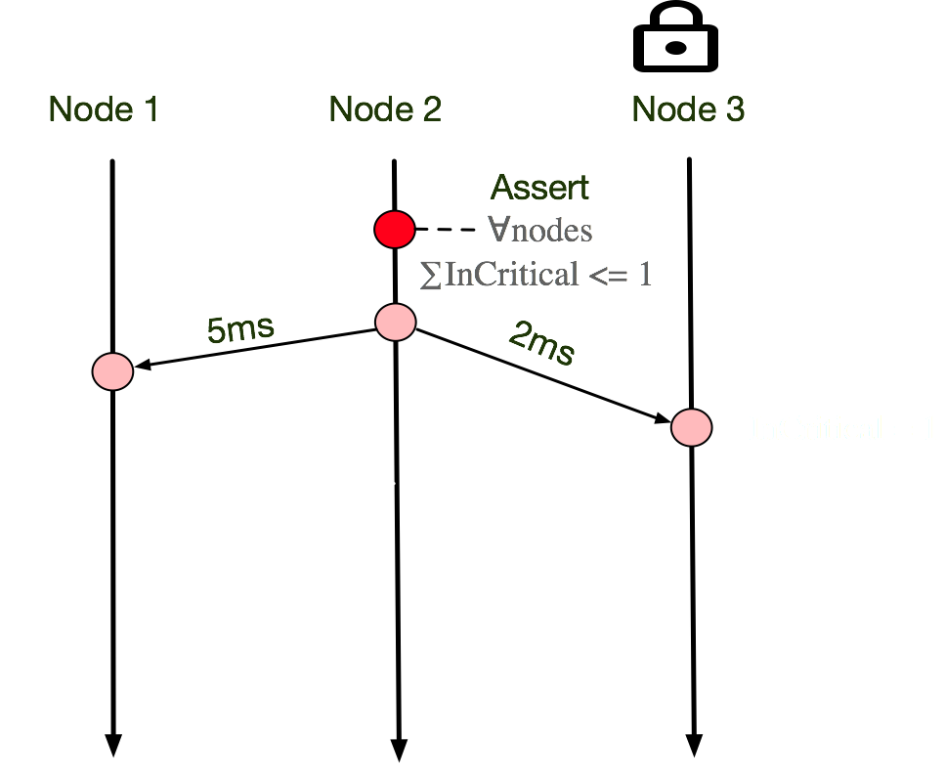
Distributed Asserts
Distributed asserts enforce invariants at runtime
Snapshots are constructed using approximate synchrony
Notes:
Dinv provides a lightweight mechanism for enforcing infrared invariants via distributed asserts. Dinv asserts are broadcast by an asserter, and a state snapshot is scheduled in a synchronized fashion. The snapshot is aggregated back to the asserter which can then compose the distributed state and evaluate the assertion. Vector clocks are used to resolve the quality of the snapshot, ie if the synchronized snapshot violated the happens-before relation.

Slide 53
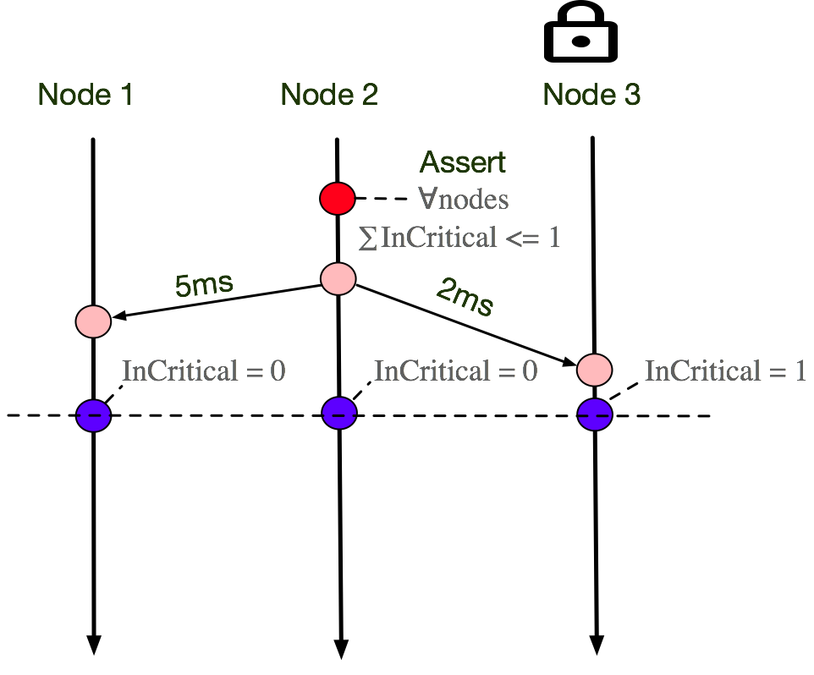
Distributed Asserts
Distributed asserts enforce invariants at runtime
Snapshots are constructed using approximate synchrony
Notes:
Dinv provides a lightweight mechanism for enforcing infrared invariants via distributed asserts. Dinv asserts are broadcast by an asserter, and a state snapshot is scheduled in a synchronized fashion. The snapshot is aggregated back to the asserter which can then compose the distributed state and evaluate the assertion. Vector clocks are used to resolve the quality of the snapshot, ie if the synchronized snapshot violated the happens-before relation.

Slide 54
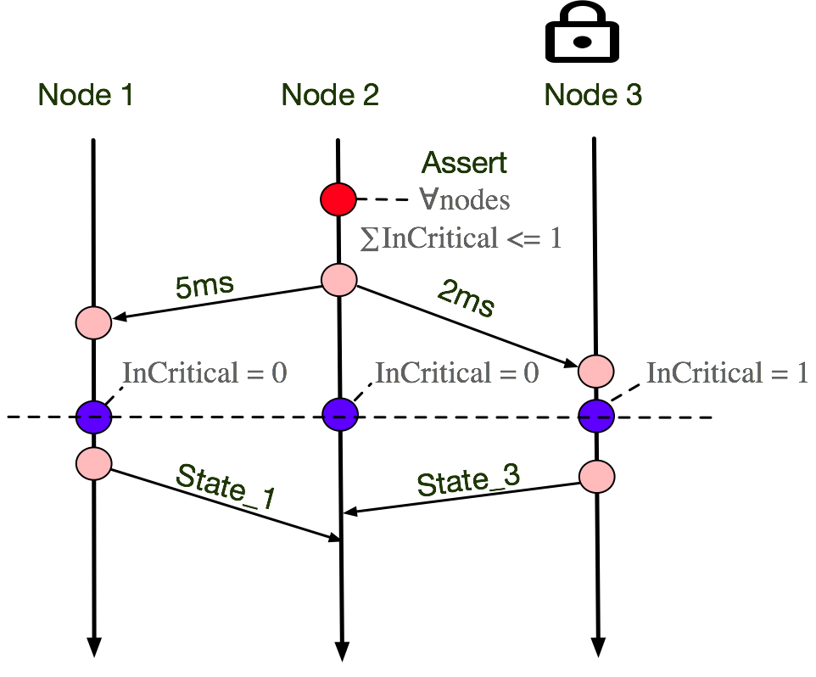
Distributed Asserts
Distributed asserts enforce invariants at runtime
Snapshots are constructed using approximate synchrony
Asserter constructs global state by aggregating snapshots
Notes:
Dinv provides a lightweight mechanism for enforcing infrared invariants via distributed asserts. Dinv asserts are broadcast by an asserter, and a state snapshot is scheduled in a synchronized fashion. The snapshot is aggregated back to the asserter which can then compose the distributed state and evaluate the assertion. Vector clocks are used to resolve the quality of the snapshot, ie if the synchronized snapshot violated the happens-before relation.

Slide 55
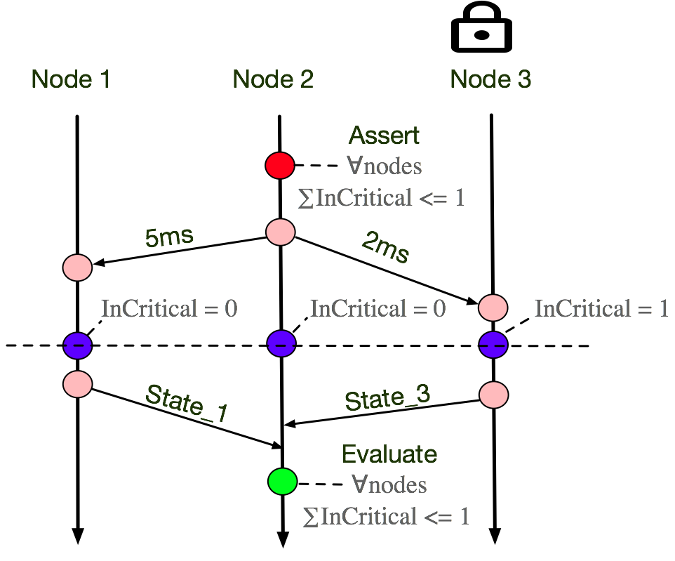
Distributed Asserts
Distributed asserts enforce invariants at runtime
Snapshots are constructed using approximate synchrony
Asserter constructs global state by aggregating snapshots
Notes:
Dinv provides a lightweight mechanism for enforcing infrared invariants via distributed asserts. Dinv asserts are broadcast by an asserter, and a state snapshot is scheduled in a synchronized fashion. The snapshot is aggregated back to the asserter which can then compose the distributed state and evaluate the assertion. Vector clocks are used to resolve the quality of the snapshot, ie if the synchronized snapshot violated the happens-before relation.

Slide 56

Evaluated Systems
Etcd: Key-Value store running Raft - 120K LOC
Serf: large scale gossiping failure detector - 6.3K LOC
Taipei-Torrent: Torrent engine written in Go - 5.8K LOC
Groupcache: Memcached written in Go - 1.7K LOC

Slide 57
Etcd ~ 120K Lines of Code
System and Targeted property | Dinv-inferred invariant | Description
Raft Strong Leader principle | ∀ follower i, len(leader log) ≥ len(i’s log) | All appended log entries must be propagated by the leader
Raft Log matching | ∀ nodes i, j if i-log[c] = j-log[c] → ∀(x ≤ c), i-log[x] = j-log[x] | If two logs contain an entry with the same index and term, then the logs are identical on all previous entries.
Raft Leader agreement | If ∃ node i, s.t i leader, than ∀ j ≠ i, j follower | If a leader exists, then all other nodes are followers.
*Raft: In search of an understandable consensus algorithm, D.Ongaro et. al
Notes:
The strong leadership property is important, but It should be second fiddle to a G O O D discription of etcd, perhaps as a replicated state machine similar to paxos, but with some N I C E simplifications which make it nice to use.

Slide 58
Etcd ~ 120K Lines of Code
System and Targeted property | Dinv-inferred invariant | Description
Raft Strong Leader principle | ∀ follower i, len(leader log) ≥ len(i’s log) | All appended log entries must be propagated by the leader
Raft Log matching | ∀ nodes i, j if i-log[c] = j-log[c] → ∀(x ≤ c), i-log[x] = j-log[x] | If two logs contain an entry with the same index and term, then the logs are identical on all previous entries.
Raft Leader agreement | If ∃ node i, s.t i leader, than ∀ j ≠ i, j follower | If a leader exists, then all other nodes are followers.
Injected Bugs for each invariant caught with assertions
*Raft: In search of an understandable consensus algorithm, D.Ongaro et. al
Notes:
The strong leadership property is important, but It should be second fiddle to a G O O D discription of etcd, perhaps as a replicated state machine similar to paxos, but with some N I C E simplifications which make it nice to use.

Slide 59
Etcd ~ 120K Lines of Code
System and Targeted property | Dinv-inferred invariant | Description
Raft Strong Leader principle | ∀ follower i, len(leader log) ≥ len(i’s log) | All appended log entries must be propagated by the leader
Raft Log matching | ∀ nodes i, j if i-log[c] = j-log[c] → ∀(x ≤ c), i-log[x] = j-log[x] | If two logs contain an entry with the same index and term, then the logs are identical on all previous entries.
Raft Leader agreement | If ∃ node i, s.t i leader, than ∀ j ≠ i, j follower | If a leader exists, then all other nodes are followers.
Injected Bugs for each invariant caught with assertions
See the paper for full system evaluation
*Raft: In search of an understandable consensus algorithm, D.Ongaro et. al
Notes:
The strong leadership property is important, but It should be second fiddle to a G O O D discription of etcd, perhaps as a replicated state machine similar to paxos, but with some N I C E simplifications which make it nice to use.

Slide 60


Limitations and future work
Limitations
Dinv’s dynamic analysis is incomplete
Ground state sampling is poor on loosely coupled systems
Large number of generated invariants
Future work
Extend analysis to temporal invariants
Bug Isolation
Distributed test case generation
Mutation testing/analysis based on mined invariants

Slide 61
Dinv: Contributions
Analysis for distributed Go systems
Automatic distributed state invariant inference
Static identification of distributed state
Automatic static instrumentation
Post-execution merging of distributed states
Runtime checking: distributed assertions
∀nodes InCritical <= 1
Repo: https://bitbucket.org/bestchai/dinv
Demo: https://www.youtube.com/watch?v=n9fH9ABJ6S4

Slide 62
Backup Slides - Failure
What about failures? Failures are not explicit in the logs we treat them as the end of executions / they can neither hold, nor corroborate invariants if they die. If a Failure is followed by a restart, the vector clocks are read in from disk and it’s treated as a single execution

Slide 63
Backup Slides Ground States
Q) What if an invariant is broken but not visable in a ground state?
As I said the technique is a heuristic to reduce analysis time, if nessisarty the pipeline can be run on the whole set of consistant cuts, but it takes orders of magnitude longer. We found in practice that the whole set of consistant cuts is highly redundent, and that ground states often had similar coverage, for example the execution of a log statement in a for loop causes a massive explosion of state, but it is usually intermittant to the larger distributed computation.

Slide 64
Invariant Quality
Q) With what confidence do you have that your distributed invariants hold?
A) It depends on the number of bucketed states. Short executions with erratic protocols such as gossip, yeild low confidence invariants, and require longer executions
Future work: We execute the system in a model checker Modist NSDI 09, to explore every interleaving, and get high quality invariants.

